Slide 1
Storage and Transport of Bulk Solids (Mechanical Operations, Audio-Visual Lecture Series)
Powders and Bulk Solids (D. Schulze)
Relevant chapters: 9, 10

Slide 2
Mechanical Operations
Length scale: micron to cm
Study of processing, handling, characterization,
and application of wide variety of Particulate Solids
/ Bulk Solids.
Abrasive, tough, rubbery, soft, fragile,
dusty, cohesive, free flowing, sticky etc.
(powder, liquid dispersions,
granules, slurries, paste etc.)
Few major mechanical operations:
Comminution (size reduction via crushing/grinding),
Handling : Storage and Conveying (transport)
Mixing/Agitation of Solids & Pastes
Separation: Screening, Filtration, Centrifugation based separation (cyclone separator),
Gravity based Settling
Fluidization

Slide 3
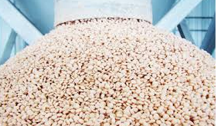
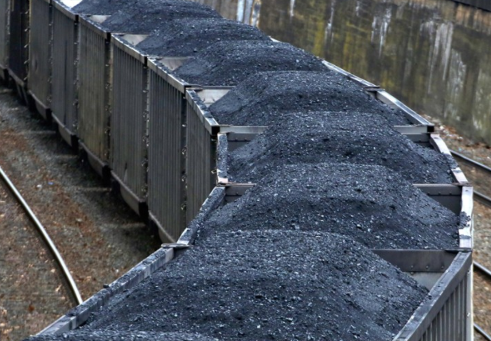
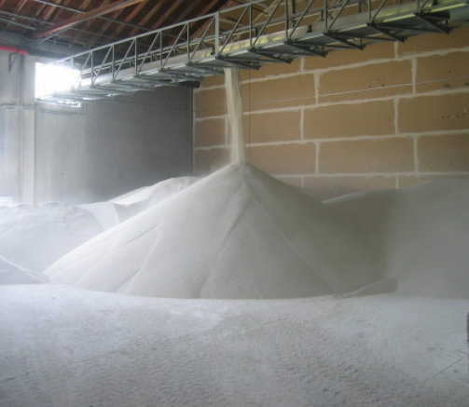
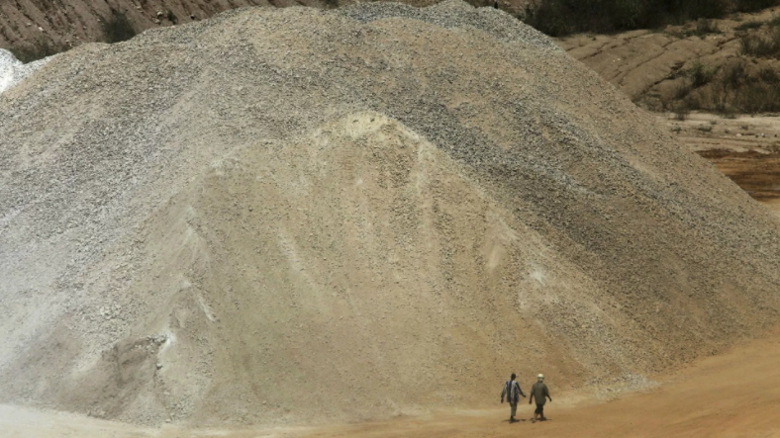
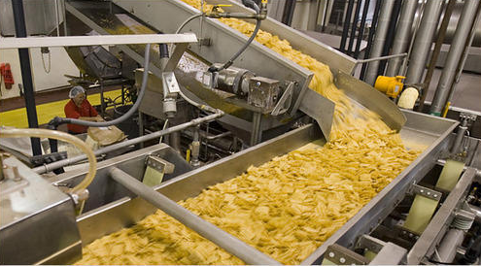

Storage and Transport of Bulk Solids
Agriculture
Mineral processing
Fertilizer industry
Construction materials
Food processing
Pharmaceutical production
chemical processing
power generation
Pulp and Paper Industry
Rubber/Plastic industry………etc.

Slide 4
Is storage is really an important issue??
Long term preservation: minimizing the quality degradation of stored material .
(Protection from external factors: Humidity, Temperature fluctuation,
insects, chemical impurities etc.)
Bulk solids are complex fluids (neither liquid nor solid) : nature of flow is very complex. The way of storage is very crucial for transportation/flowability of materials.
The inadequate knowledge of stress profile lead to bad design, and causing over-run, downtime, production losses and rectification costs, and ultimately maximizing the production cost.
Value addition to the final product.

Slide 5
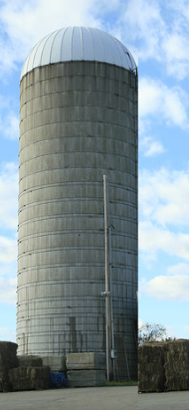
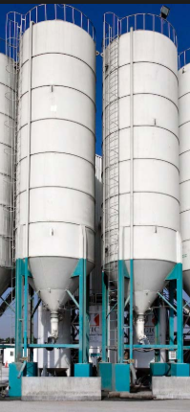
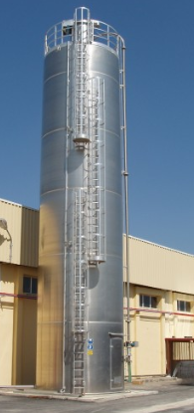
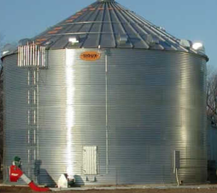
Silos
Bins
Larger diameter, Small height
Made of steel
specified humidity and temperature condition
Vented
Mainly for dry materials
Smaller diameter, Tall
Made of concrete, wood, steel
specified humidity and temperature condition
Sealed (air-tight)

Slide 6
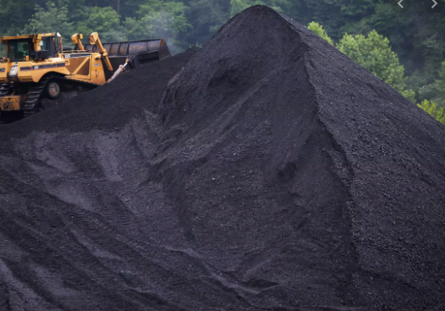
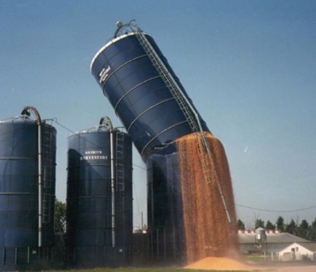
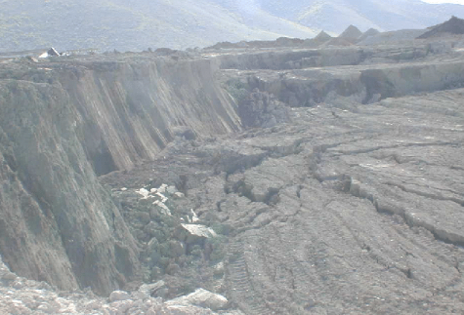
Stress Distribution in bulk solids

Slide 7

the way you store, it matters..
www.jenike.com

Slide 8

the way you store, it matters..
Flow problems:
Bridging/Arching and Ratholing
https://www.siperm.com/en/

Slide 9
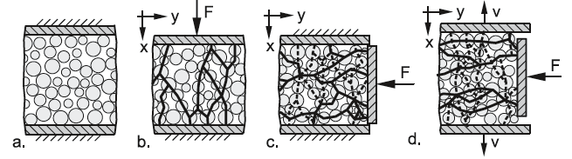
Stress Propagation in Bulk Solids

Slide 10
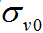
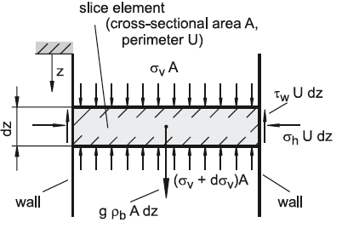
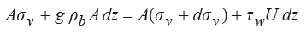
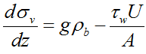
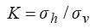
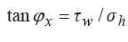
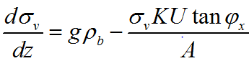
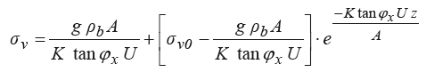
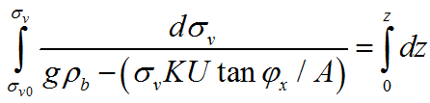
z =0
Force Balance for slice element
z
Angle of Wall Friction
K: Lateral Stress Ratio (Principle stress ratio)
We assume K is constant throughout the material.
In reality K varies through out the material.

Slide 11
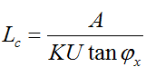
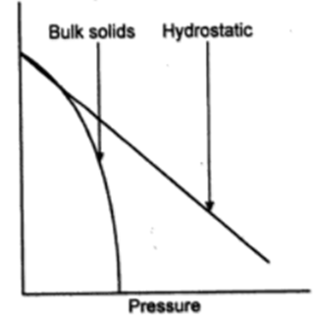
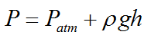
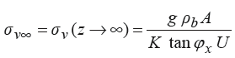
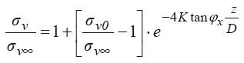
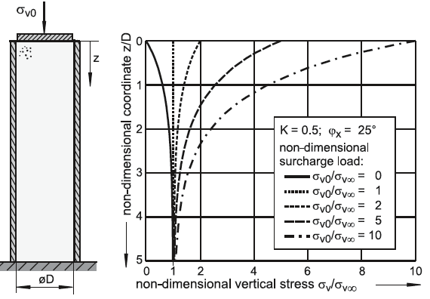
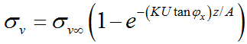
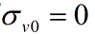
Z=0
z

Slide 12
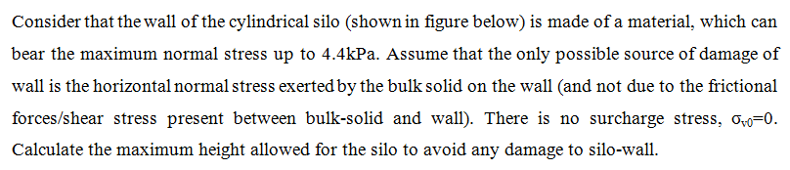
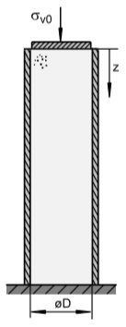
Application of Janssen’s equation
Example 1 (by group 1)

Slide 13
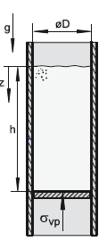
Example 2 (by group 2)
Consider a case wherein a column of bulk solid should be pushed upwards in a vertical channel, the wall shear stress on bulk solids then start acting downwards. Find out the expression for stress as a function of depth.

Slide 14
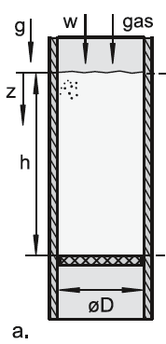
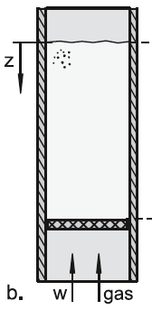
Example 3 (by group 3)
If a gas flows through a stationary packing of bulk solid, the stresses in the bulk solid are influenced by the pressure gradient. This effect can be taken into account for a setup as shown in figure below by adding pressure gradient, dp/dz.

Slide 15
Summary
Within a cylindrical section of a silo, both vertical and horizontal normal stress are increasing function of depth, and saturates to a maximum value and very large depth.
The frictional forces applied by wall on material is very crucial, which makes bulk solids different than liquids.
The above expression works fine in practical sense, however more rigorous derivations are available with less assumption.

Slide 16
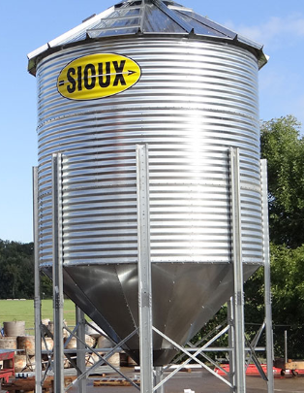
Next Class: Stress distribution in Hopper
Hoppers

